Slide 1
CALAMITY PREDICTOR
Idea
Functionality
Use-cases
References
Technology used

Slide 2
IDEA
Natural disasters like earthquakes, tsunamis, floods etc. occur every year. They cause innumerable amount of loss, both monetary as well as in terms of human lives. Disaster mitigation becomes important in order to minimize both these losses.
If we are somehow able to predict when the given natural disaster is going to occur, we can deploy relief measures and mitigate the effects of these disasters
Our idea aims to build a model which can do exactly that; predict a natural disaster. For a given geographical region, the data corresponding to past occurrences of the disaster is fed to the model and this is used to predict a future occurrence of a natural disaster.

Slide 3
FUNCTIONALITY
The web-app on the first screen will contain a list of disasters for which the prediction must be made.
The user selects one among them and is then redirected to a second screen where the user is asked to select a location.
After selection a given geographical location, the ML model will take the location, process the required parameters and will give out the prediction for the disaster.
This can be used to take measures to mitigate the effects of the disaster.

Slide 4
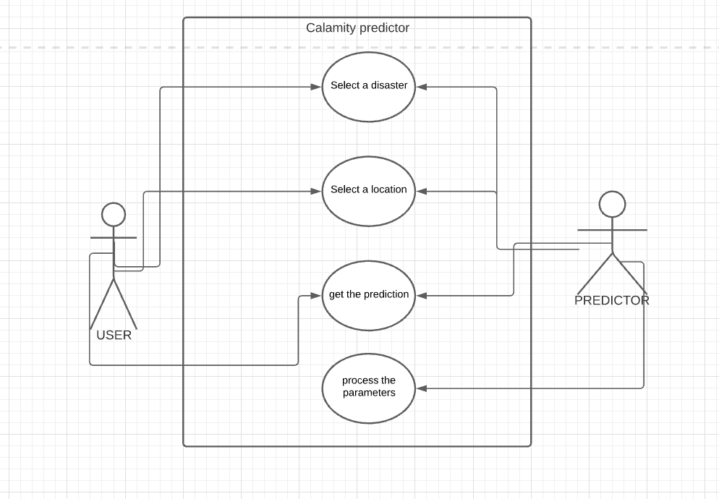
USE CASE DIAGRAM

Slide 5
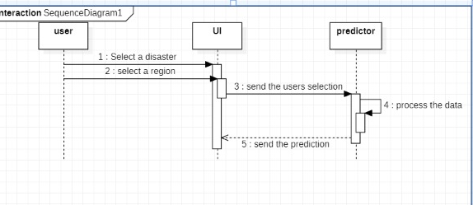
SEQUENCE DIAGRAM

Slide 6
TECHNOLOGIES AND TOOLS USED
FRONT-END :
HTML
CSS
Bootstrap
BACK-END:
Scitlearn
Pandas
Numpy
KNN
Colab ( tools)
Kaggle (Dataset)

